Slide 1
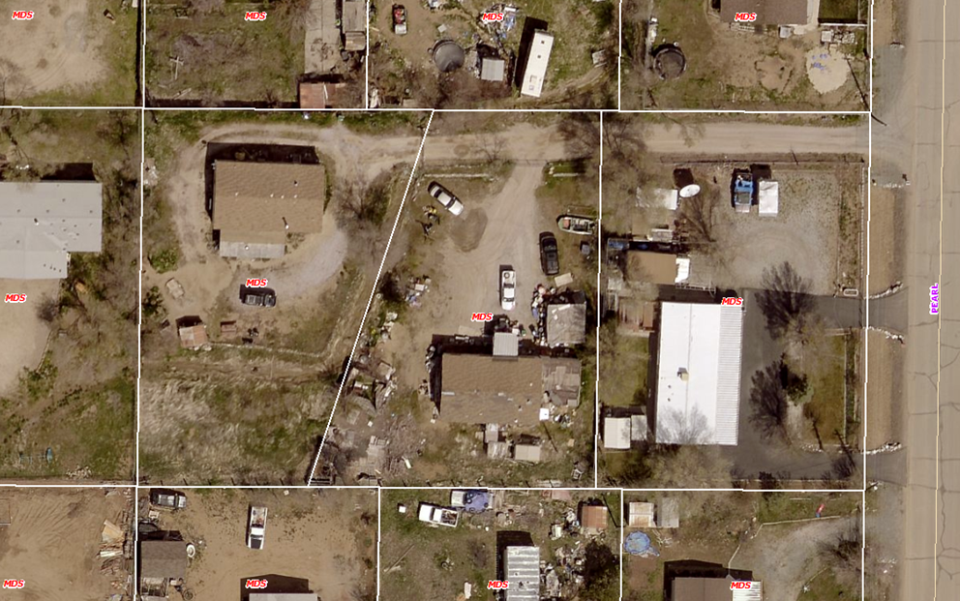
WPVAR18-0006 David Wood
Washoe County
Board of Adjustment
October 4, 2018

Slide 2
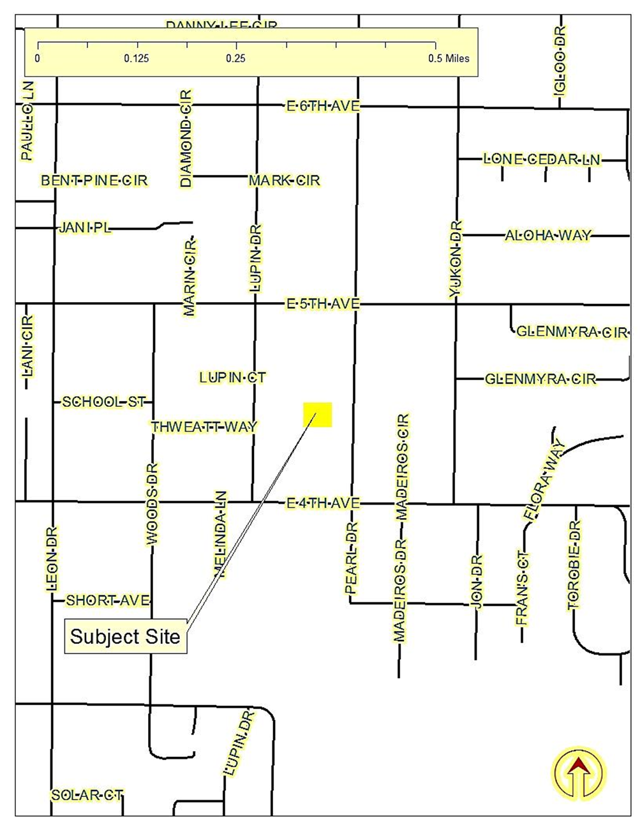
Location
5443 and 5445 Pearl Drive, Sun Valley

Slide 3
Overview
Reduce the side yard setback from 8 feet to 5 feet and the rear yard setback from 20 feet to 8 feet on one parcel of land; and to reduce the front yard setback from 20 feet to 8 feet and the rear yard setback from 20 feet to 15 feet on an adjacent parcel of land. The reductions in setbacks would be applicable only after an associated boundary line adjustment was also approved.

Slide 4
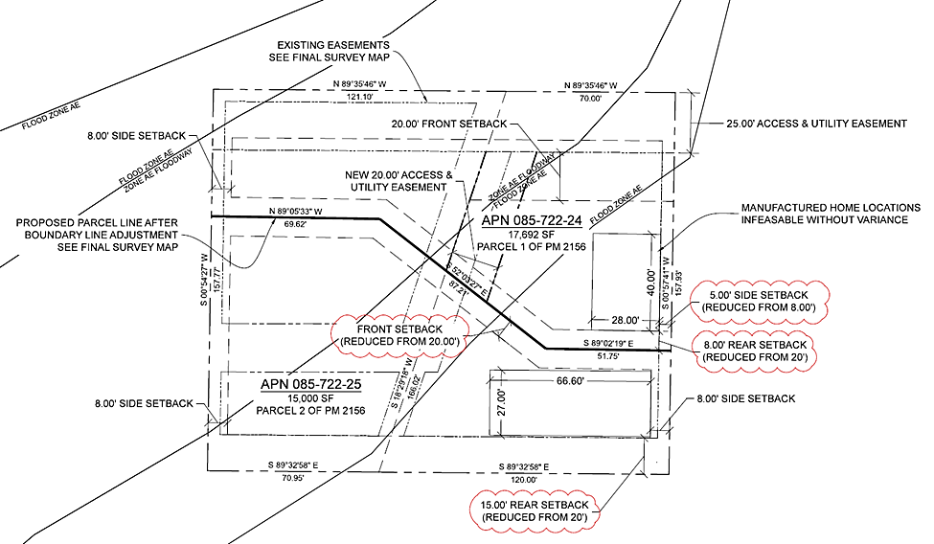
Proposed Site Plan

Slide 5
Variance Purpose
The purpose of a Variance is to provide a means of altering the requirements in specific instances where the strict application of those requirements would deprive a property of privileges enjoyed by other properties with the identical regulatory zone because of special features or constraints unique to the property involved.

Slide 6
Variance Evaluation
Nevada Revised Statues (NRS) limits the power of the Board of Adjustment to grant variances only under particular circumstances. The applicant has the responsibility to demonstrate that the subject property exhibits one or more of the following characteristics to demonstrate a hardship: 1) exceptional narrowness, shallowness, or shape of a specific piece of property; or 2) by reason of exceptional topographic conditions; or 3) other extraordinary and exceptional situation or condition of the piece of property.

Slide 7
Variance Evaluation
The subject parcels are not exceptionally narrow, shallow nor oddly shaped, they include no exceptional topography.
The subject parcels are, however, significantly encumbered by “Flood Zone AE” as well as “Zone AE Floodway.”

Slide 8
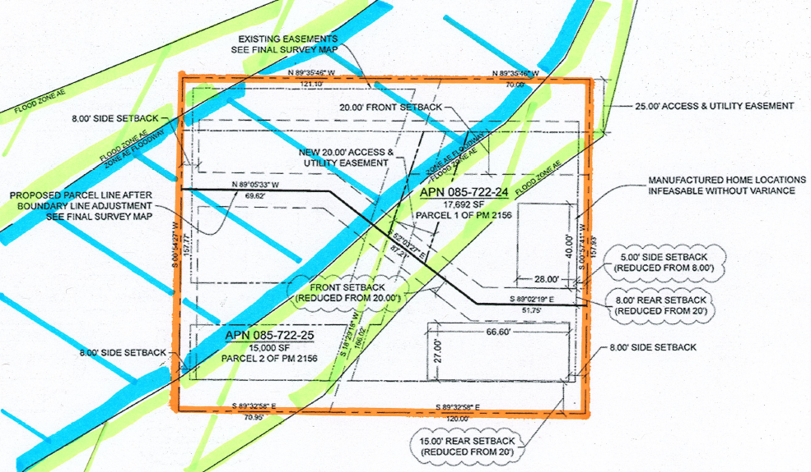
Variance Evaluation

Slide 9
Variance Evaluation
Evaluation on pages 8 and 9 of the Staff Report.
The Sun Valley Citizens Advisory Board did not meet, no comments from individual members was received by staff.

Slide 10
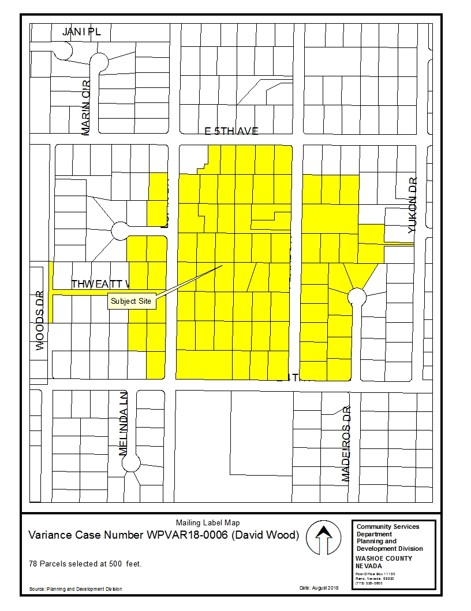
Public Notice
78 Parcels noticed at 500 foot radius

Slide 11
Commenting Agencies
No recommendations for denial were received from reviewing agencies.
Technical conditions of approval have been included from the Planning and Building Division.

Slide 12
Variance Findings
Findings and evaluation can be found on page 8 of the staff report.
Staff believes that all required findings, including “Special Circumstances,” can be made as the site is encumbered by a flood way and flood zone. Granting the requested variances to required building setbacks does not grant special privileges inconsistent with the limitations upon other properties in the vicinity and the identical regulatory zone.

Slide 13
Possible Motion
I move that, after giving reasoned consideration to the information contained in the staff report and information received during the public hearing, the Washoe County Board of Adjustment approve Variance Case Number WPVAR18-0006 for David Wood, with the Conditions of Approval included as Exhibit A for this matter, having made all required findings in accordance with Washoe County Development Code Section 110.804.25.

